Slide 1
Processing of Expression Data
R programming practice 1

Slide 2
1. General flowchart for GEO expression data processing
Given the complex data types in GEO, the diverse platforms, the large variety of sample information, and the vast differences in data storage formats, there are a variety of ways to process GEO data. However, the general process includes the following steps:
Find the right data set
Download
Annotation
Outlier handling
Differential analysis: limma, edgR, DESeq2, t-test, rank-sum test, etc.
https://rpubs.com/jrgonzalezISGlobal/transcriptomic_analyses
limma is suitable for continuous data, e.g. microarray data, while edgeR / DESeq / DESeq2 is suitable for count data, e.g. high-throughput sequencing (RNA-seq) data. If count data is converted to continuous data, limma can also be used.
Two types of data are usually included
Expression profiles
Sample Information
Notes:
Papalexi E and Satija R. Single-cell RNA sequencing to explore immune cell heterogeneity, Nature Reviews Immunology 2018 (https://doi.org/10.1038/ nri.2017.76)
https://www.bioconductor.org/packages/devel/bioc/vignettes/limma/inst/doc/usersguide.pdf

Slide 3
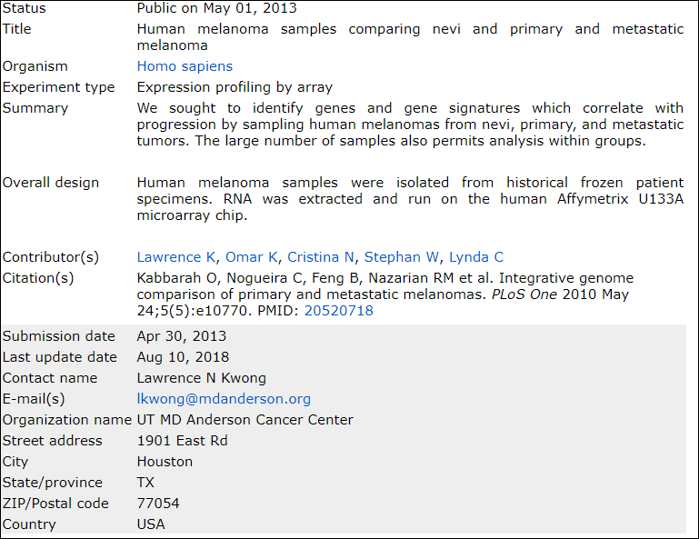
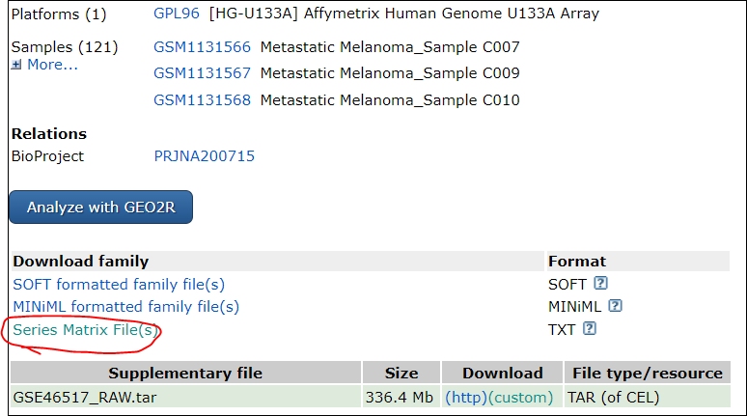
2. Handling of Affy data
1. From the original CEL file
Take GSE46517 as an example
https://www.ncbi.nlm.nih.gov/geo/query/acc.cgi?acc=GSE46517
Usually using the series matrix data

Slide 4
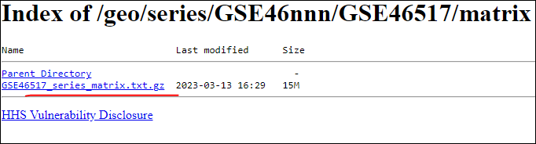
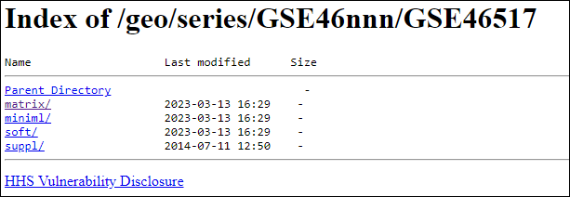
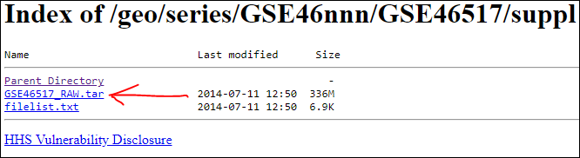
GSE46517 data download

Slide 5
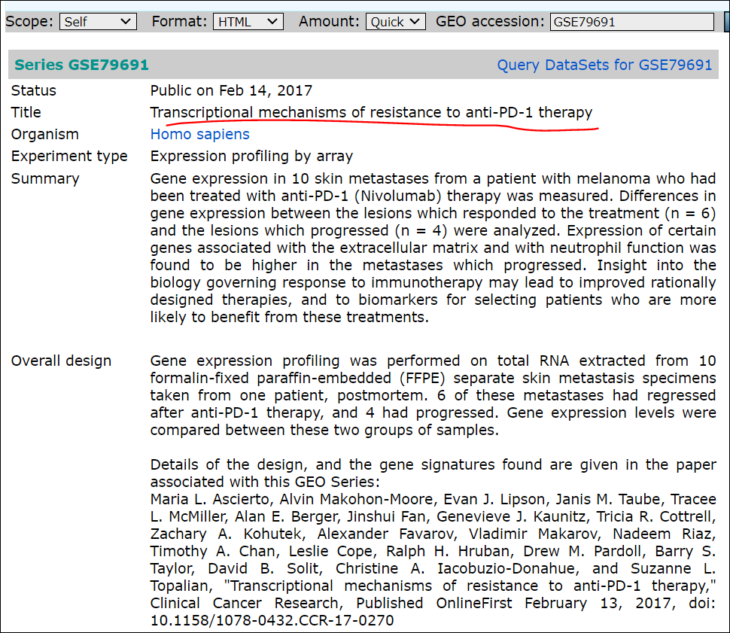
GSE79691
2. No CEL files
Take GSE79691 as an example
https://www.ncbi.nlm.nih.gov/geo/query/acc.cgi?acc=GSE79691

Slide 6
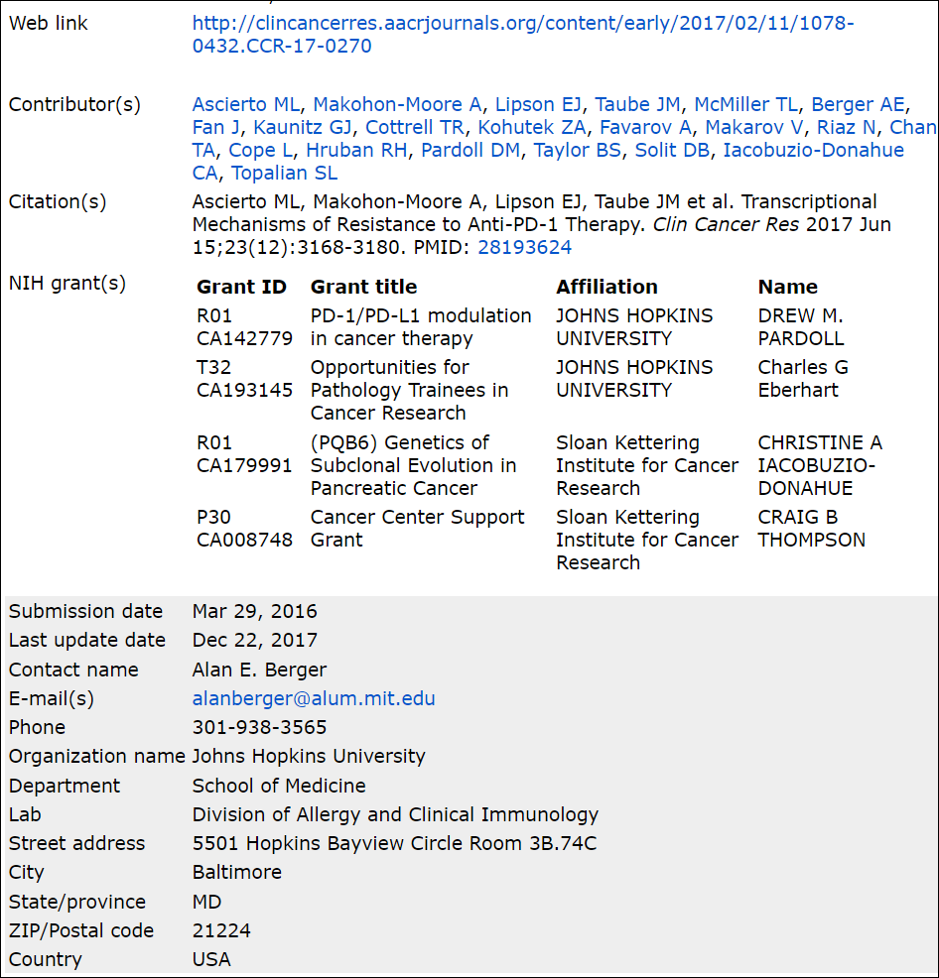
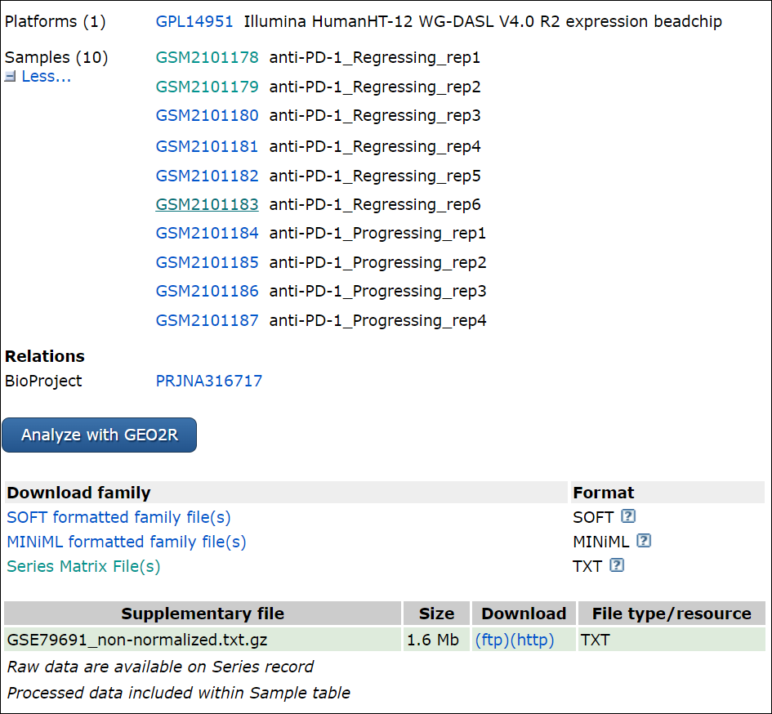

Slide 7
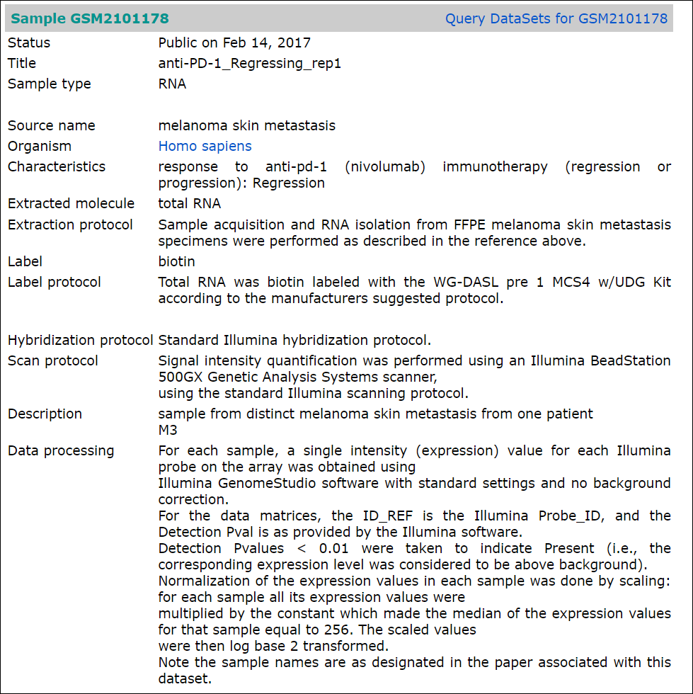
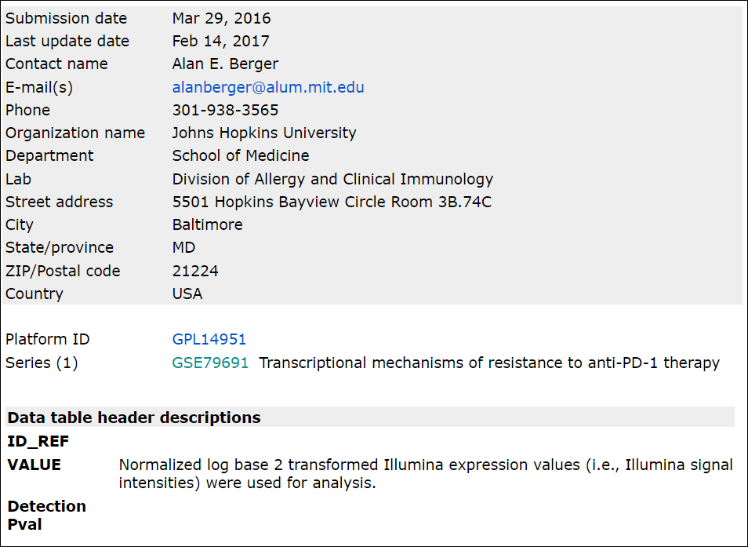
View sample in detail
https://www.ncbi.nlm.nih.gov/geo/query/acc.cgi?acc=GSM2101178

Slide 8
3. Advanced analysis of expression data
GO and KEGG enrichment analysis:
GSEA
Immune microenvironment estimation

